Slide 1

PROFILING
Tenacious

Slide 2
Profiling
The profiling API provides information about a variety of events and actions that occur in the common language runtime. You can use this information to monitor the inner workings of processes and to analyze the performance of your .NET Framework application.

Slide 3
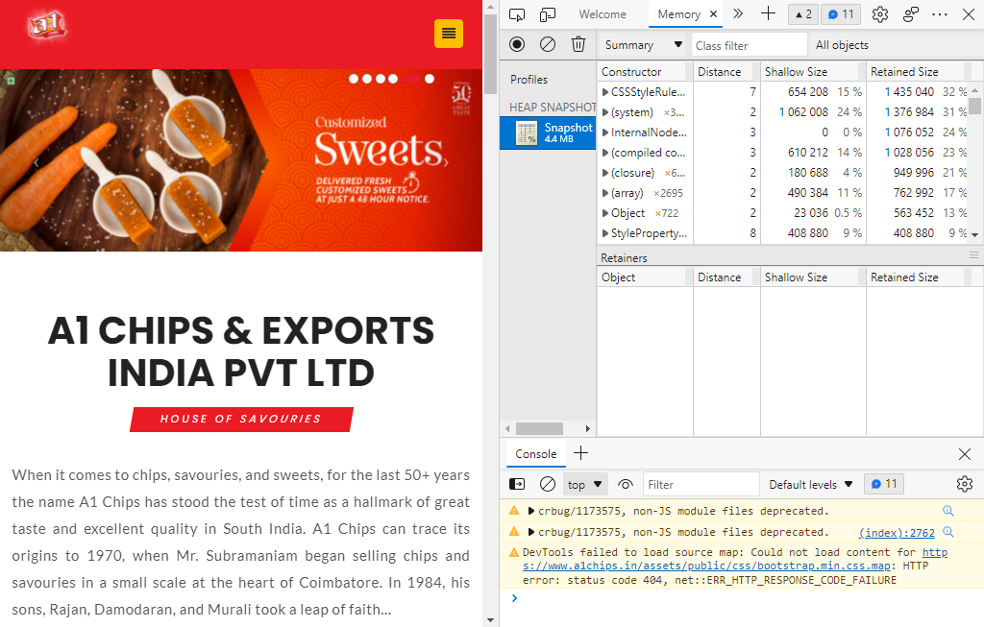
MEMORY
Notes:
This slide is only for the trainer… You can display the poll from GTM and after the poll is taken, share the result, connect the poll result with the topic. Once done, you can hide the poll so that the PPT is visible.
I have created the poll in the GTM webinar.

Slide 4
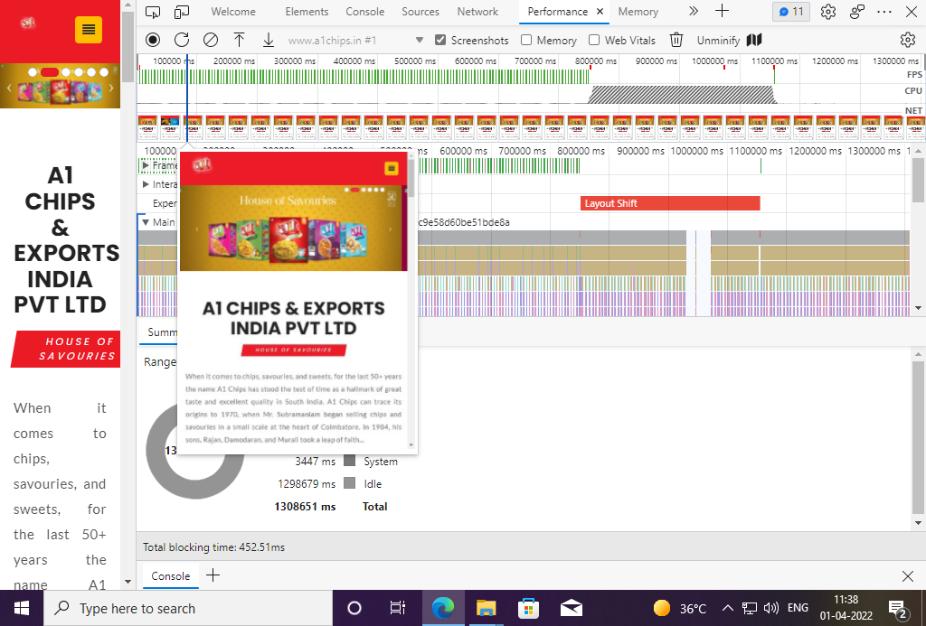
PERFORMANCE

Slide 5
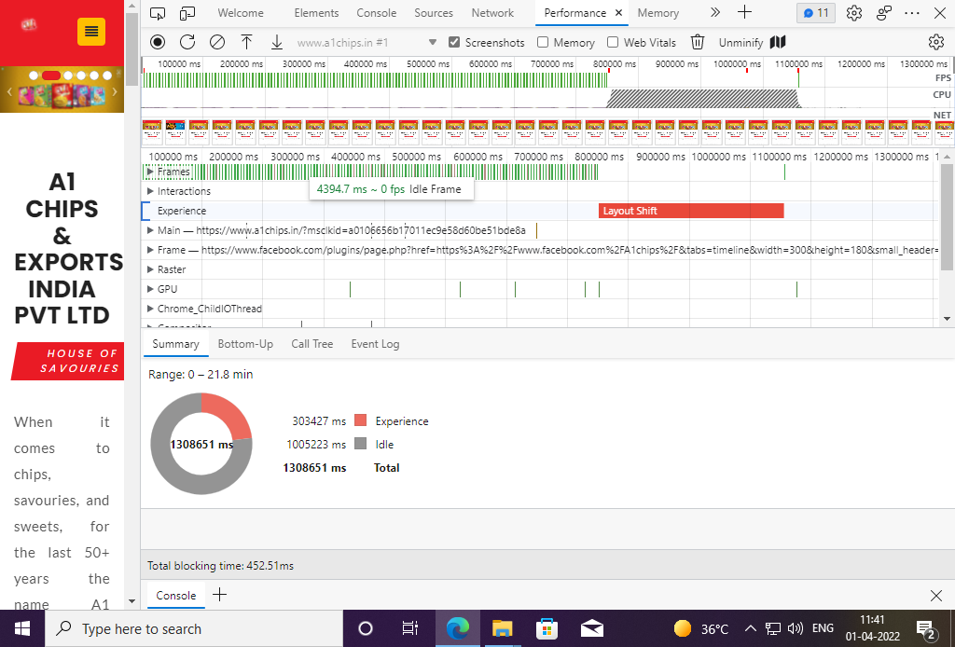
PERFORMANCE

Slide 6
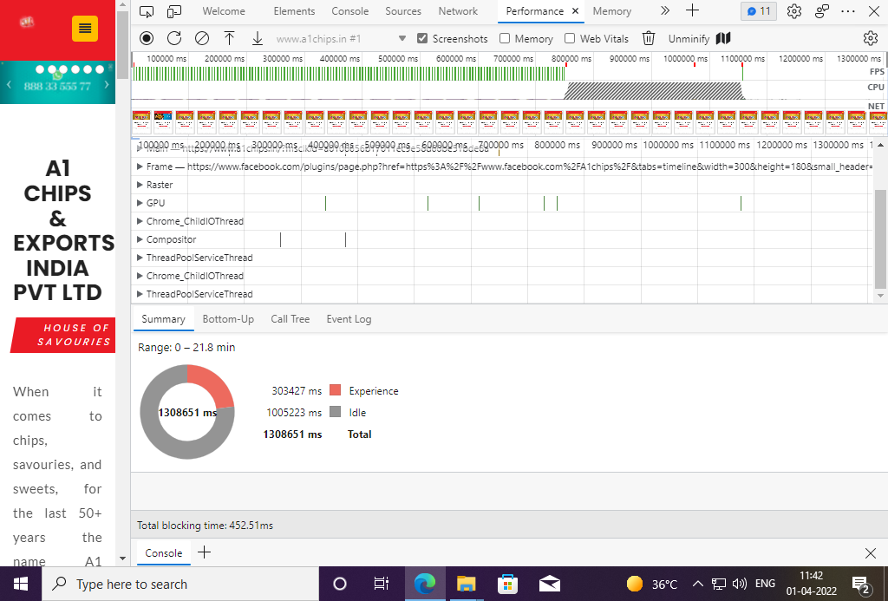
PERFORMANCE

Slide 7
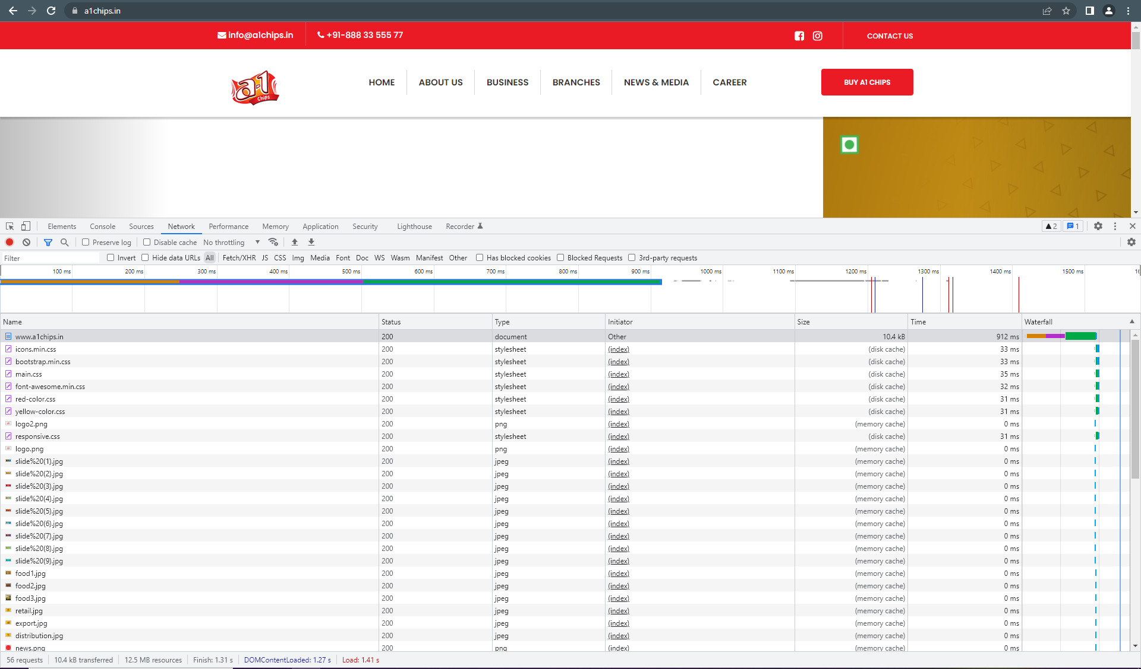
NETWORK

Slide 8
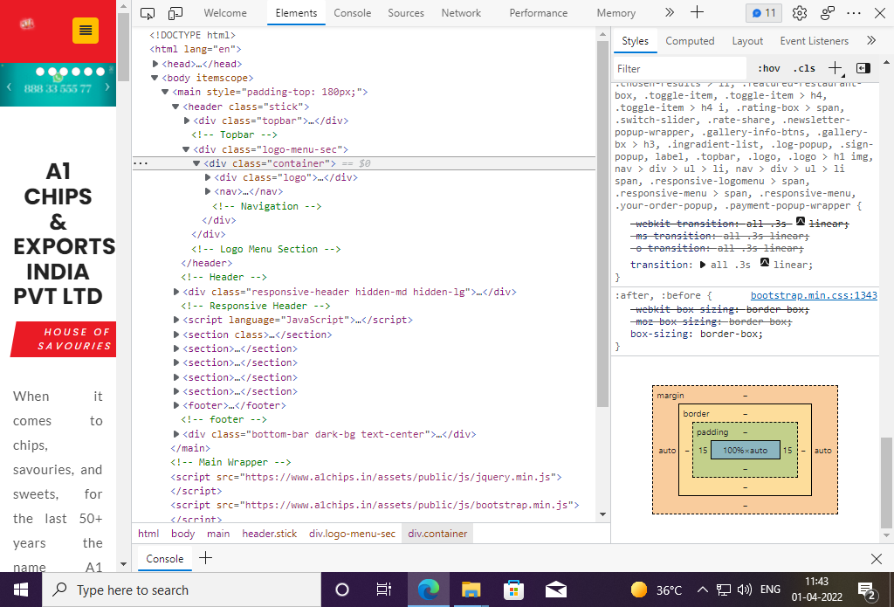
ELEMENTS

Slide 9


